Slide 1


KEYLOGGER AND SECURITY
--G.ANAND BALAJI

Slide 2

KEY LOGGER
A keylogger is a programme or tool designed to monitor and keep a tab on the “keystrokes” made on the user keyboard.
This enables on compromising sensitive data like passwords etc..

Slide 3

Project analysis slide 6
AGENDA
The Main Agenda of the Keylogger experiment is to demonstrate how key logger works and to prevent it and how to create a key logger in real time .
An introduction highlighting the importance of keyloggers, followed by a detailed exploration of project objectives, technical intricacies of key press capture, and the functionality of logging keystrokes to both text and JSON files.
The agenda includes a demonstration of the GUI interface, a discussion on ethical considerations surrounding keyloggers, and a live showcase of the keylogger in operation.

Slide 4

Project analysis slide 7
PROBLEM STATMENT
Develop a sophisticated keylogger using Python, integrating the `pynput` library for key press monitoring and a user-friendly GUI designed with `tkinter`. The key objective is to create a secure and efficient keylogging tool that can accurately record and store keystrokes in various file formats. This endeavor seeks to address the need for a reliable keylogging solution that balances technical complexity with user accessibility, ensuring data integrity and ethical usage in the realm of cybersecurity and software development.

Slide 5
Project analysis slide 8
Project Overview
This project investigates keyloggers, malicious tools that covertly record keystrokes to capture sensitive information. The study aims to understand their operation, evaluate detection methods, and develop prevention strategies
.
Objectives:
Understand keylogger mechanisms.
Evaluate detection tools and techniques.
Develop and test prevention strategies.
Address ethical and privacy considerations.

Slide 6

Project analysis slide 10
Project Overview
Methodology:
Setup: Configure test environments with selected keyloggers.
Experimentation: Install keyloggers and monitor captured data.
Detection: Test various detection tools for accuracy.
Prevention: Implement and assess security measures to prevent keylogger installation.
Data Analysis: Analyze collected data to determine effectiveness.

Slide 7
Project analysis slide 11
End users of kelogger
End Users of Keyloggers
Cybercriminals:
Purpose: Steal sensitive information for financial gain or identity theft.
Corporate Espionage Agents:
Purpose: Obtain trade secrets and business strategies for competitive advantage.
Law Enforcement and Intelligence Agencies:
Purpose: Monitor suspects for criminal investigations and national security.
Employers:
Purpose: Monitor employees to prevent data leakage and ensure productivity.
Parents:
Purpose: Monitor children's online activities for safety.
Security Researchers:
Purpose: Study keylogger behavior to improve detection and prevention.
Self-Monitoring Users:
Purpose: Track personal typing activities for productivity or data recovery.

Slide 8
BENEFITS OF KEY LOGGER
Intrusion Detection: Keyloggers can be used as a part of intrusion detection systems to monitor user activity and detect suspicious behavior.
Forensic Analysis: Keyloggers can be valuable tools for digital forensic investigators when analyzing security incidents or investigating cybercrimes.
Security Research and Testing: Ethical hackers and security researchers may use keyloggers as part of penetration testing and vulnerability assessments to evaluate the security of systems and applications. By simulating real-world attack scenarios, they can identify weaknesses and recommend mitigations.

Slide 9

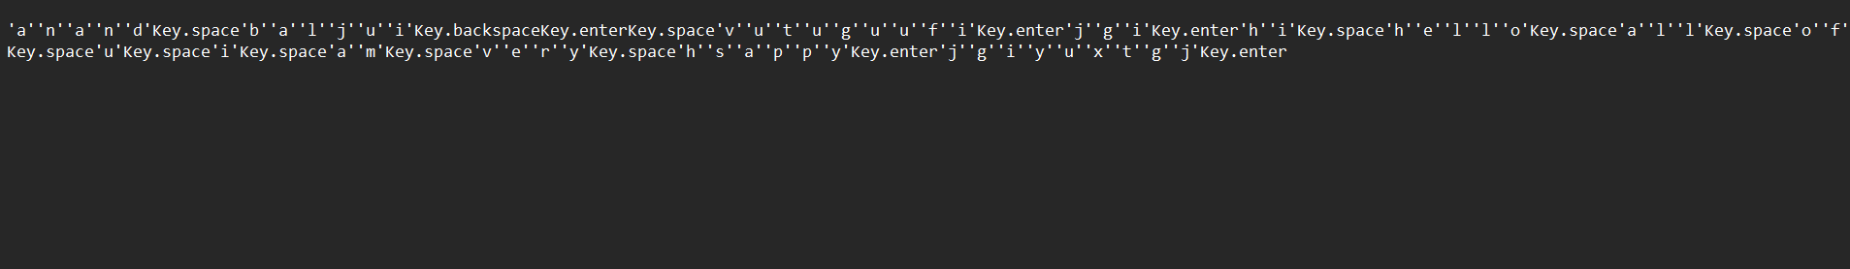
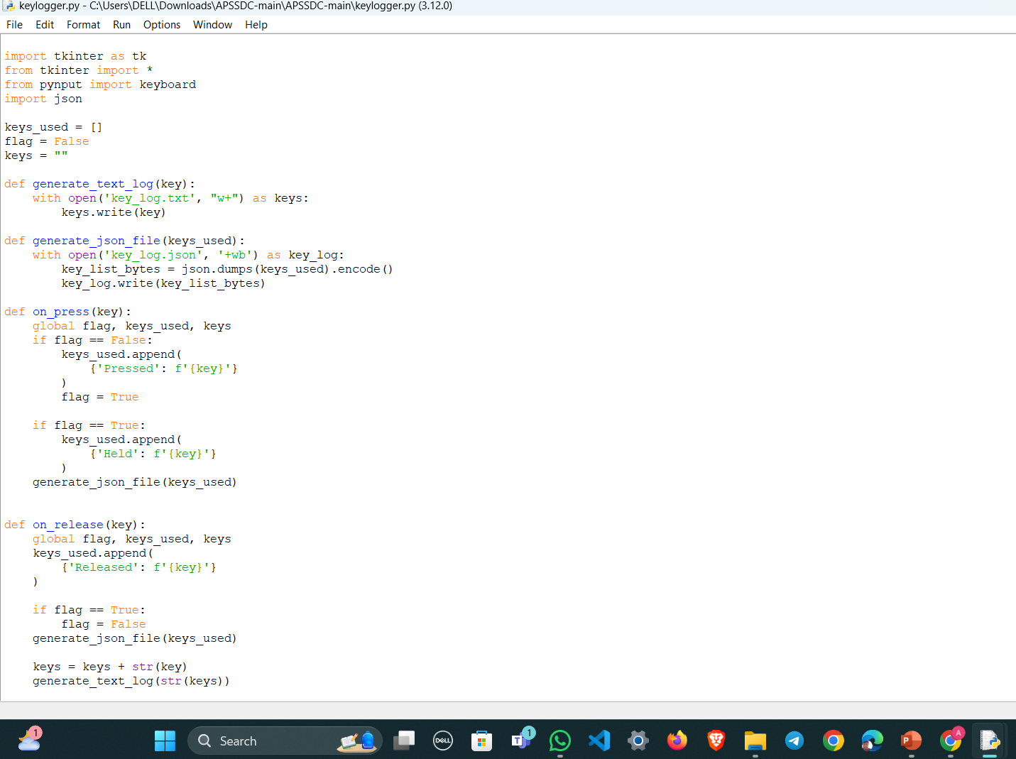
RESULTS

Slide 10
Results
Results:
Insights into keylogger functionality and effectiveness.
Evaluation of detection tools and their reliability.
Recommendations for robust preventive measures.
Discussion on ethical considerations.
Conclusion: The project aims to enhance keylogger threat understanding, improve detection capabilities, and strengthen preventive measures, contributing to better cybersecurity practices.

Slide 11
Thank You

Slide 12
https://github.com/anandbalaji526533/apcs.git

